Slide 1
Computer Architecture Experiment
Topic 1. Pipelined CPU supporting RISC-V
RV32I Instructions
浙江大学计算机学院
2024年9月

Slide 2
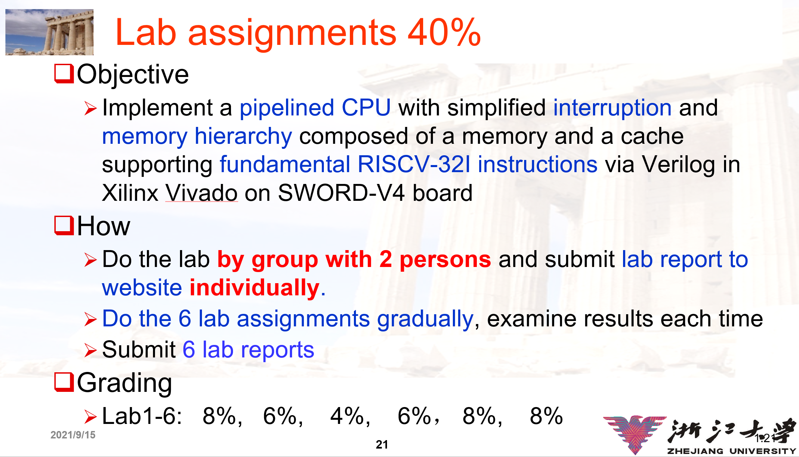

Slide 3
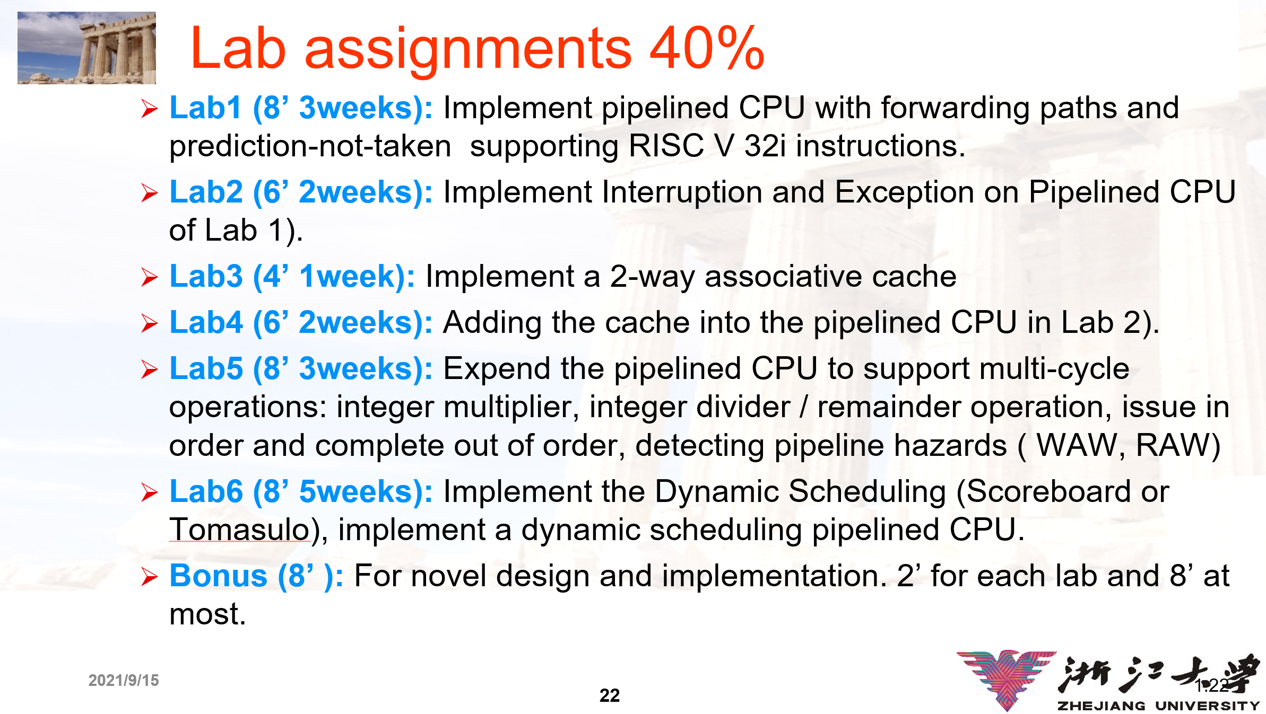

Slide 4
实验要求
实验可2人组队或个人完成，分数无差别
每次实验分数包括报告分数（40%）与验收分数（60%）
实验报告提交严格按照学在浙大系统中的时间提交，即使没有完全做完，也要把原理部分和实验进展写到位。实验报告的分数只会按照是否完整打分，没有做完但已经努力做了不会扣分。对于简单应付，报告小于2页者，50分封顶
实验验收时间宽松，就实验结果和部分理论知识进行抽查。每位同学每次实验2次验收机会。

Slide 5
Outline
Experiment Purpose
Experiment Task
Basic Principle
Operating Procedures
Checkpoints

Slide 6
Experiment Purpose
Understand RISC-V RV32I instructions
Master the design methods of pipelined CPU executing RV32I instructions
Master the method of Pipeline Forwarding Detection and bypass unit design
Master the methods of 1-cycle stall of Predict-not-taken branch design
master methods of program verification of Pipelined CPU executing RV32I instructions

Slide 7
Experiment Task
Design of Pipelined CPU executing RV32I instructions.
Design datapath
Design Bypass Unit
Design CPU Controller
Verify the Pipelined CPU with program and observe the execution of program

Slide 8
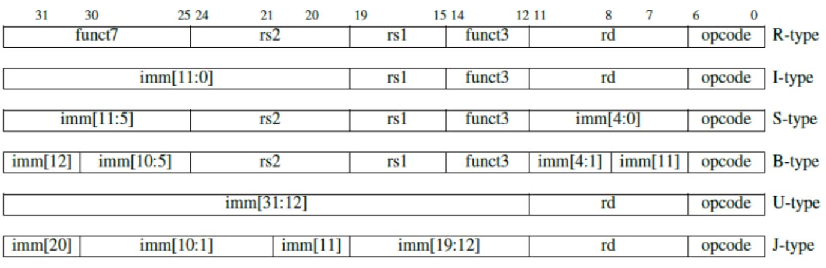
Pipelined CPU supporting execution of RV32I instructions

Slide 9
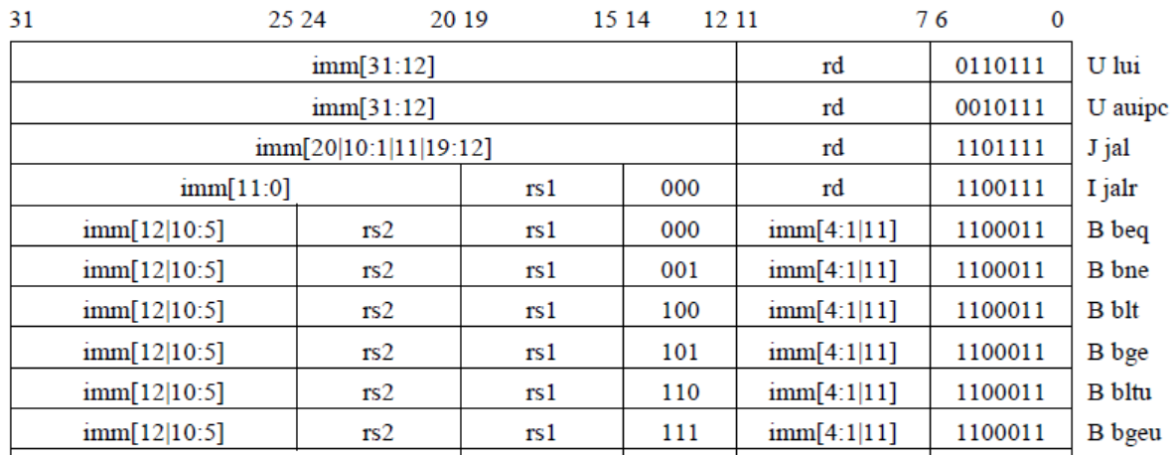
Pipelined CPU supporting execution of RV32I instructions

Slide 10
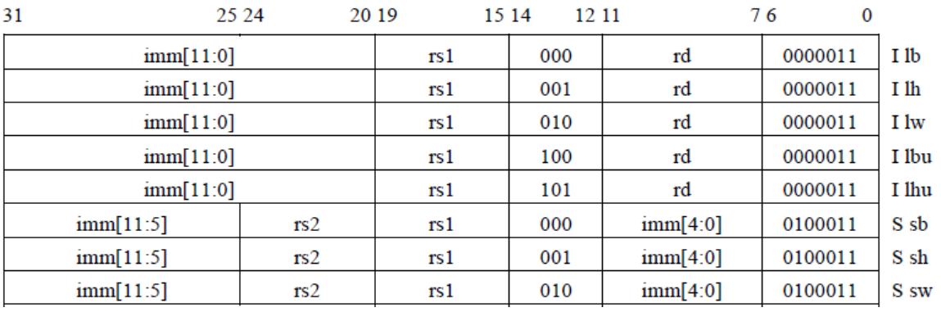
Pipelined CPU supporting execution of RV32I instructions

Slide 11
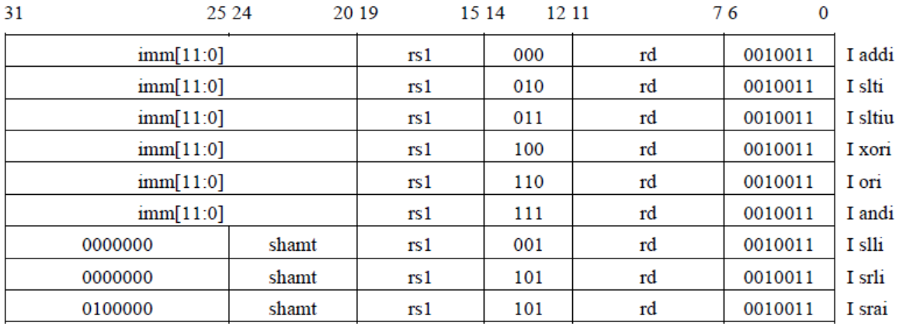
Pipelined CPU supporting execution of RV32I instructions

Slide 12
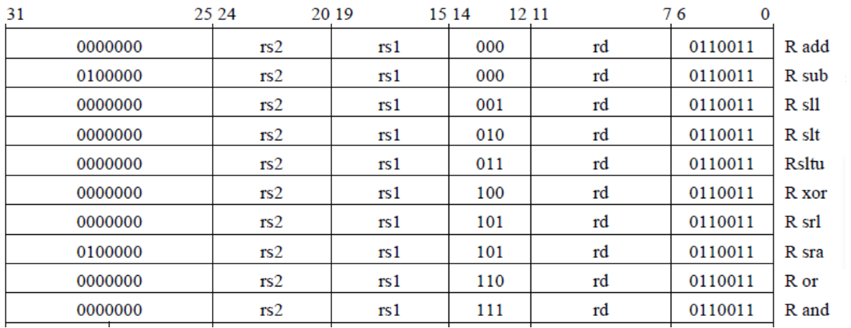
Pipelined CPU supporting execution of RV32I instructions

Slide 13
Instruction Demo

Slide 14
Data Hazard Causes Stalls

Slide 15
Pipeline Forward to Avoid the Data hazard

Slide 16
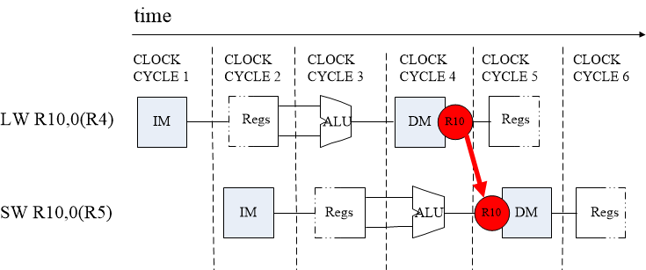
SW After LW

Slide 17
Condition in Which Bypass Unit doesn’t work

Slide 18
Pipeline Stalls

Slide 19
Instruction Demo

Slide 20
Execution result

Slide 21
Methods of resolving Control hazards
Freeze or flush the pipeline
Predict-not-taken
Predict-taken
Delayed branch

Slide 22
Freeze method

Slide 23
Predict-not-taken

Slide 24
Predict-taken method
60% of branch result is taken
Bring forward calculation of branch condition from MEM Stage to EX Stage, stall reduce from 3-cycle to 2-cycle.
Then bring forward from EX to ID, stall reduce from 2-cycle to 1-cycle.
1-cycle stall may be used for 1 delay slot

Slide 25
Stalls of Predict Methods for Control Hazard
Predict Methods | Status | Original Datapath | Address Calculation Forward | Condition Comparison Forward
Predict-taken | Hit (Need Branch) | 3 stall | 1 stall | 1 stall
Predict-taken | Miss (No Branch) | 3 stall | 3 stall | 1 stall
Predict-not-taken | Hit (No Branch) | go on | go on | go on
Predict-not-taken | Miss (Need Branch) | 3 stall | 3 stall | 1 stall

Slide 26
Pipelined CPU supporting RV32I instructions

Slide 27
Pipelined CPU supporting RV32I instructions

Slide 28
Pipelined CPU supporting RV32I instructions

Slide 29
Pipelined CPU supporting RV32I instructions

Slide 30
Instr. Mem.(1)
NO. | Instruction | Addr. | Label | ASM | Comment
0 | 00000013 | 0 | __start: | addi x0, x0, 0
1 | 00402103 | 4 |  | lw x2, 4(x0)
2 | 00802203 | 8 |  | lw x4, 8(x0)
3 | 004100b3 | C |  | add x1, x2, x4
4 | fff08093 | 10 |  | addi x1, x1, -1
5 | 00c02283 | 14 |  | lw x5, 12(x0)
6 | 01002303 | 18 |  | lw x6, 16(x0)
7 | 01402383 | 1C |  | lw x7, 20(x0)
8 | 402200b3 | 20 |  | sub x1,x4,x2
9 | 002270b3 | 24 |  | and x1,x4,x2
10 | 002260b3 | 28 |  | or x1,x4,x2
11 | 002240b3 | 2C |  | xor x1,x4,x2
12 | 002210b3 | 30 |  | sll x1,x4,x2
13 | 002220b3 | 34 |  | slt x1,x4,x2
14 | 004120b3 | 38 |  | slt x1,x2,x4

Slide 31
Instr. Mem.(2)
NO. | Instruction | Addr. | Label | ASM | Comment
15 | 002350b3 | 3C |  | srl x1, x6, x2
16 | 402350b3 | 40 |  | sra x1, x6, x2
17 | 4023d0b3 | 44 |  | sra x1, x7, x2
18 | 007330b3 | 48 |  | sltu x1, x6, x7
19 | 0063b0b3 | 4C |  | sltu x1, x7, x6
20 | 00000033 | 50 |  | add x0,x0,x0
21 | ffd50093 | 54 |  | addi x1,x10,-3
22 | 00f27093 | 58 |  | andi x1,x4,15
23 | 00f26093 | 5C |  | ori x1,x4,15
24 | 00f24093 | 60 |  | xori x1,x4,15
25 | 00f22093 | 64 |  | slti x1,x4,15
26 | 00121093 | 68 |  | slli x1,x4,1
27 | 00225093 | 6C |  | srli x1,x4,2
28 | 40c35093 | 70 |  | srai x1, x6, 12
29 | fff33093 | 74 |  | sltiu x1, x6, -1

Slide 32
Instr. Mem.(3)
NO. | Instruction | Addr. | Label | ASM | Comment
30 | fff3b093 | 78 |  | sltiu x1, x7, -1
31 | 00520863 | 7C |  | beq x4,x5,label0
32 | 00420663 | 80 |  | beq x4,x4,label0
33 | 00000013 | 84 |  | addi x0,x0,0
34 | 00000013 | 88 | label0: | addi x0,x0,0
35 | 00421863 | 8C |  | bne x4,x4,label1
36 | 00521663 | 90 |  | bne x4,x5,label1
37 | 00000013 | 94 |  | addi x0,x0,0
38 | 00000013 | 98 | label1: | addi x0,x0,0
39 | 0042c863 | 9C |  | blt x5,x4,label2
40 | 00524663 | A0 |  | blt x4,x5,label2
41 | 00000013 | A4 |  | addi x0,x0,0
42 | 00000013 | A8 | label2: | addi x0,x0,0
43 | 00736863 | AC |  | bltu x6,x7,label3
44 | 0063e663 | B0 |  | bltu x7,x6,label3

Slide 33
Instr. Mem.(4)
NO. | Instruction | Addr. | Label | ASM | Comment
45 | 00000013 | B4 |  | addi x0,x0,0
46 | 00000013 | B8 | label3: | addi x0,x0,0
47 | 00525863 | BC |  | bge x4,x5,label4
48 | 0042d663 | C0 |  | bge x5,x4,label4
49 | 00000013 | C4 |  | addi x0,x0,0
50 | 00000013 | C8 | label4: | addi x0,x0,0
51 | 0063f863 | CC |  | bgeu x7,x6,label5
52 | 00737663 | D0 |  | bgeu x6,x7,label5
53 | 00000013 | D4 |  | addi x0,x0,0
54 | 00000013 | D8 | label5: | addi x0,x0,0
55 | 00425663 | DC |  | bge x4,x4,label6
56 | 00000013 | E0 |  | addi x0,x0,0
57 | 00000013 | E4 | label6: | addi x0,x0,0
58 | 000040b7 | E8 |  | lui x1,4
59 | 00c000ef | EC |  | jal x1,12

Slide 34
Instr. Mem.(5)
NO. | Instruction | Addr. | Label | ASM | Comment
60 | 00000013 | F0 |  | addi x0,x0,0
61 | 00000013 | F4 |  | addi x0,x0,0
62 | 01802403 | F8 |  | lw x8, 24(x0)
63 | 00802e23 | FC |  | sw x8, 28(x0)
64 | 01c02083 | 100 |  | lw x1, 28(x0)
65 | 02801023 | 104 |  | sh x8, 32(x0)
66 | 02002083 | 108 |  | lw x1, 32(x0)
67 | 02800223 | 10C |  | sb x8, 36(x0)
68 | 02402083 | 110 |  | lw x1, 36(x0)
69 | 01a01083 | 114 |  | lh x1, 26(x0)
70 | 01a05083 | 118 |  | lhu x1, 26(x0)
71 | 01b00083 | 11C |  | lb x1, 27(x0)
72 | 01b04083 | 120 |  | lbu x1, 27(x0)
73 | ffff0097 | 124 |  | auipc x1, 0xffff0
74 | 000000e7 | 128 |  | jalr x1,0(x0)

Slide 35
Data Mem.
NO. | Data | Addr. | Comment
0 | 000080BF | 0
1 | 00000008 | 4
2 | 00000010 | 8
3 | 00000014 | C
4 | FFFF0000 | 10
5 | 0FFF0000 | 14
6 | FF000F0F | 18
7 | F0F0F0F0 | 1C
8 | 00000000 | 20
9 | 00000000 | 24
10 | 00000000 | 28
11 | 00000000 | 2C
12 | 00000000 | 30
13 | 00000000 | 34
14 | 00000000 | 38
15 | 00000000 | 3C
NO. | Instruction | Addr. | Comment
16 | 00000000 | 40
17 | 00000000 | 44
18 | 00000000 | 48
19 | 00000000 | 4C
20 | A3000000 | 50
21 | 27000000 | 54
22 | 79000000 | 58
23 | 15100000 | 5C
24 | 00000000 | 60
25 | 00000000 | 64
26 | 00000000 | 68
27 | 00000000 | 6C
28 | 00000000 | 70
29 | 00000000 | 74
30 | 00000000 | 78
31 | 00000000 | 7C

Slide 36
Test Bench
RV32core core(
.debug_en(1'b0),
.debug_step(1'b0),
.debug_addr(7'b0),
.debug_data(),
.clk(clk),
.rst(rst),
.interrupter(1'b0)
);
initial begin
clk = 0;
rst = 1;
#2 rst = 0;
end
always #1 clk = ~clk;

Slide 37
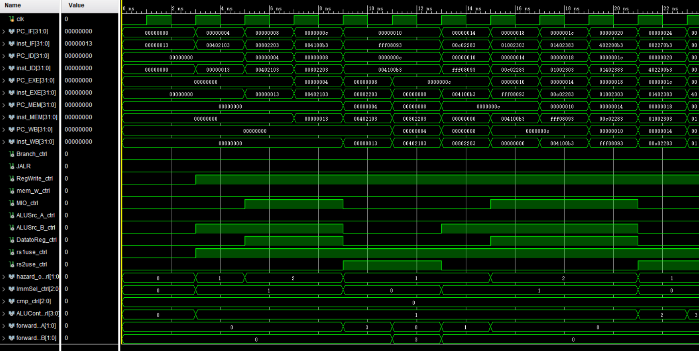
Simulation (1)

Slide 38
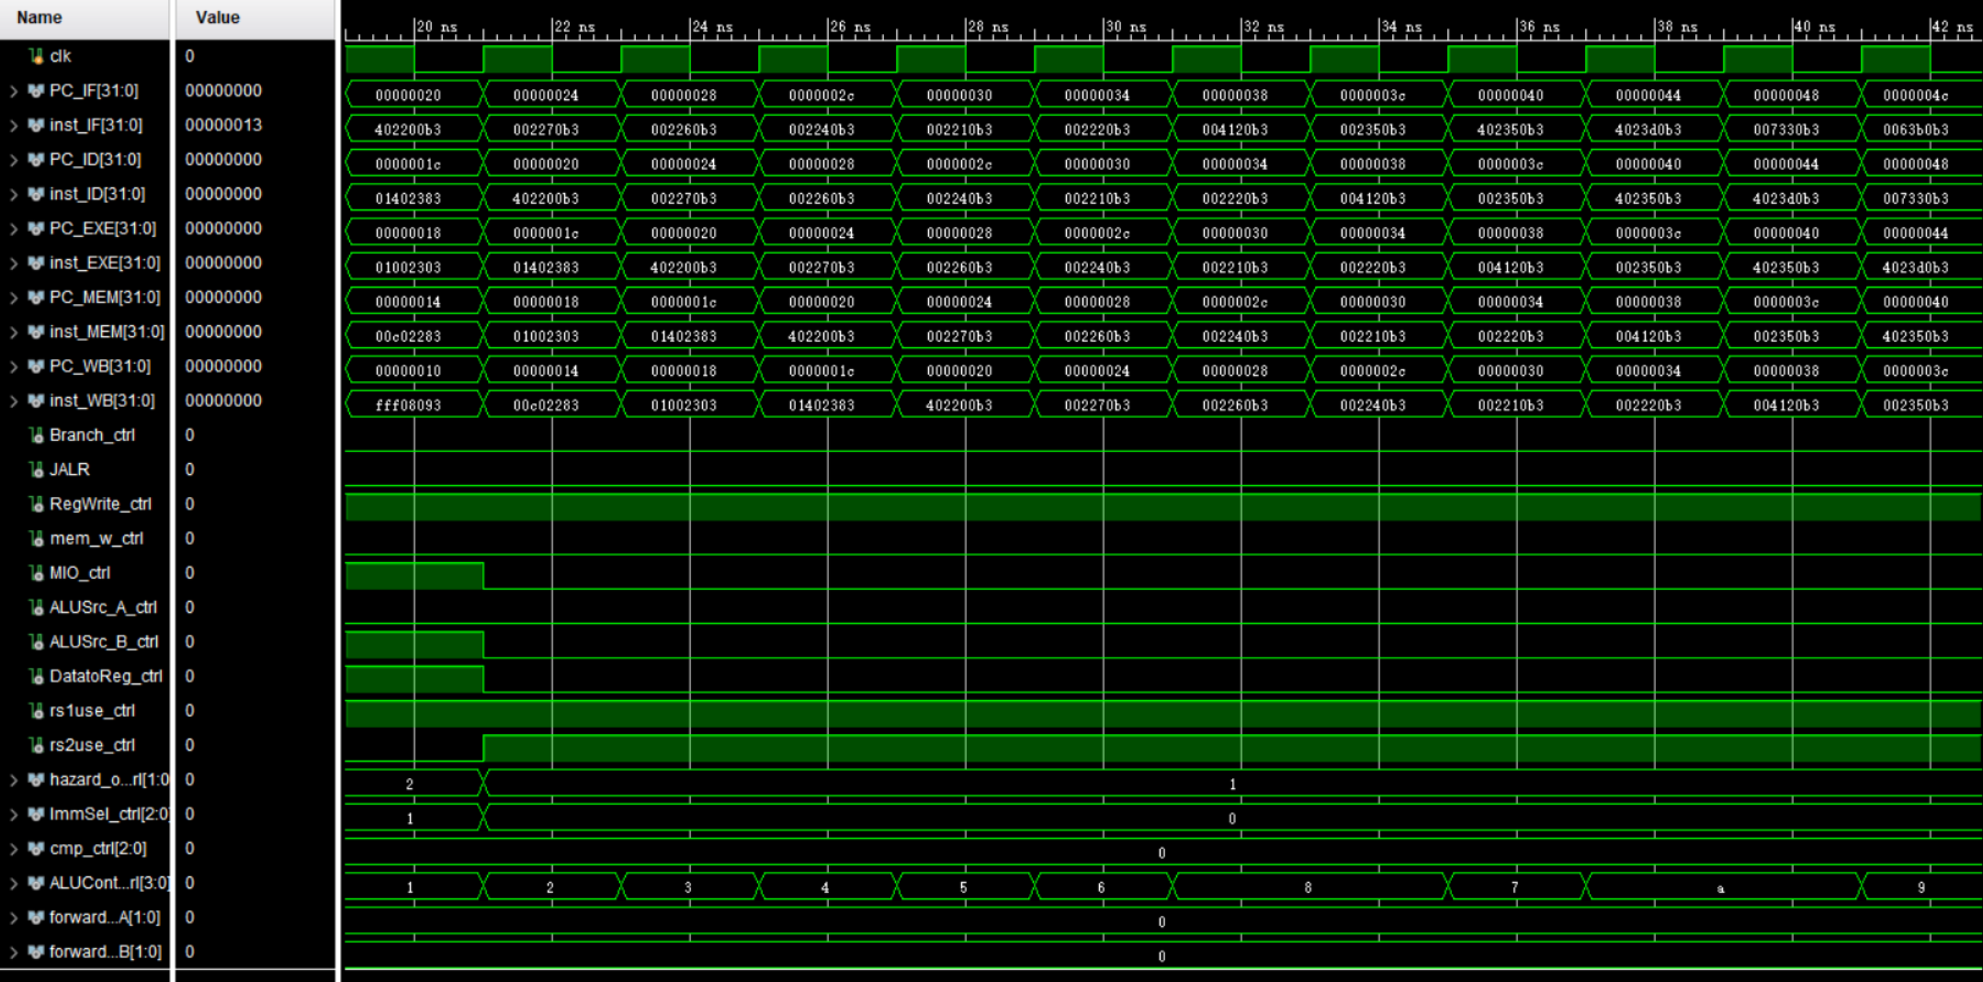
Simulation (2)

Slide 39
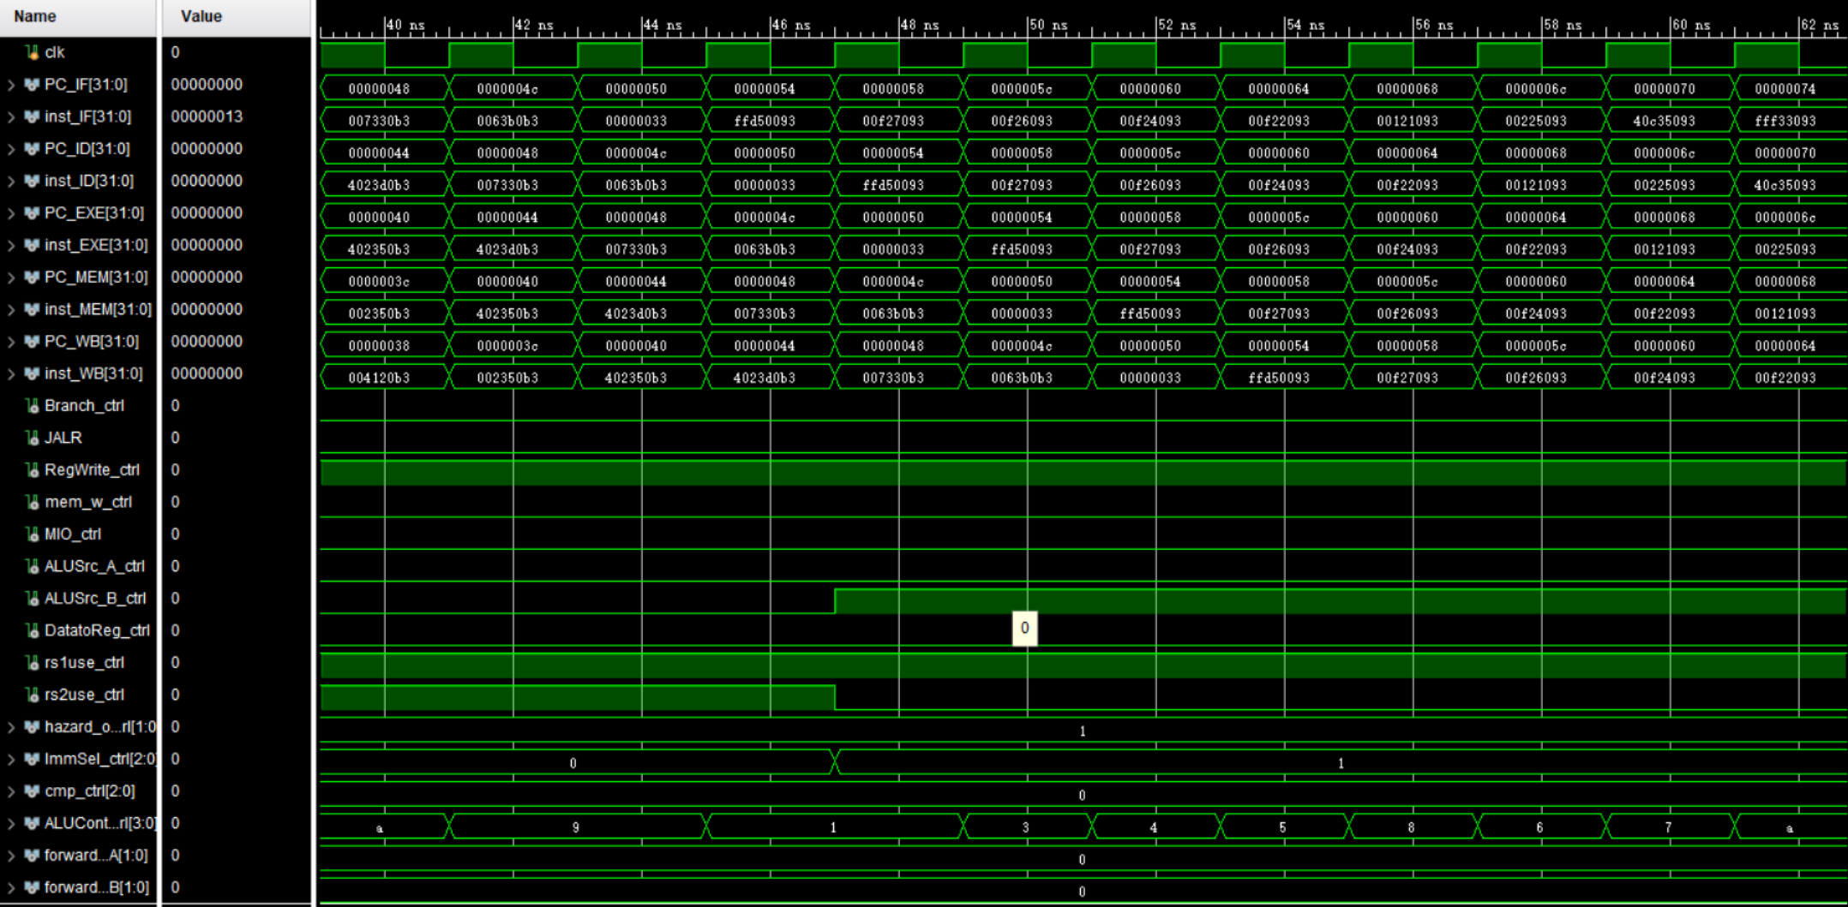
Simulation (3)

Slide 40
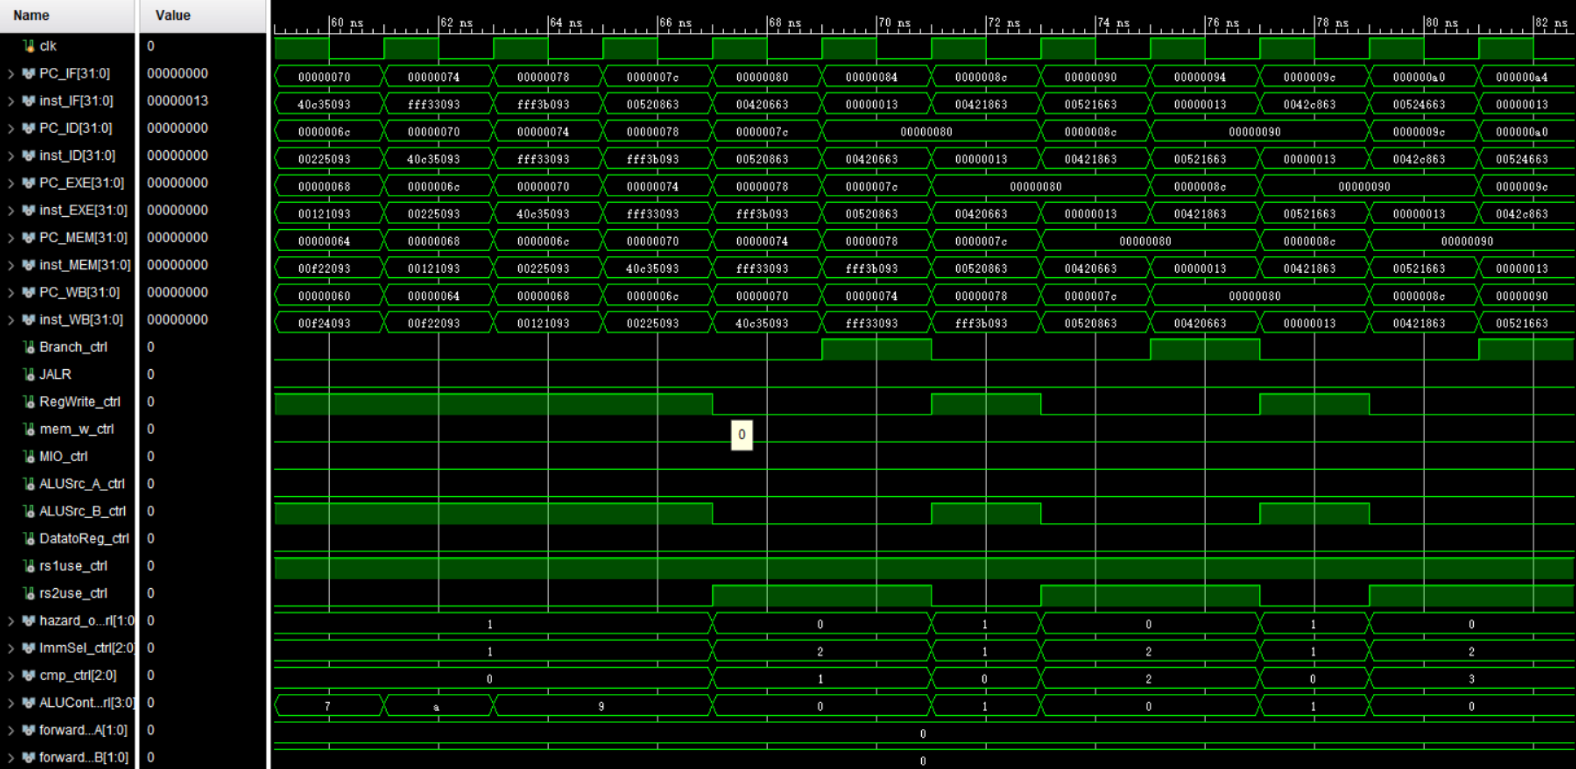
Simulation (4)

Slide 41
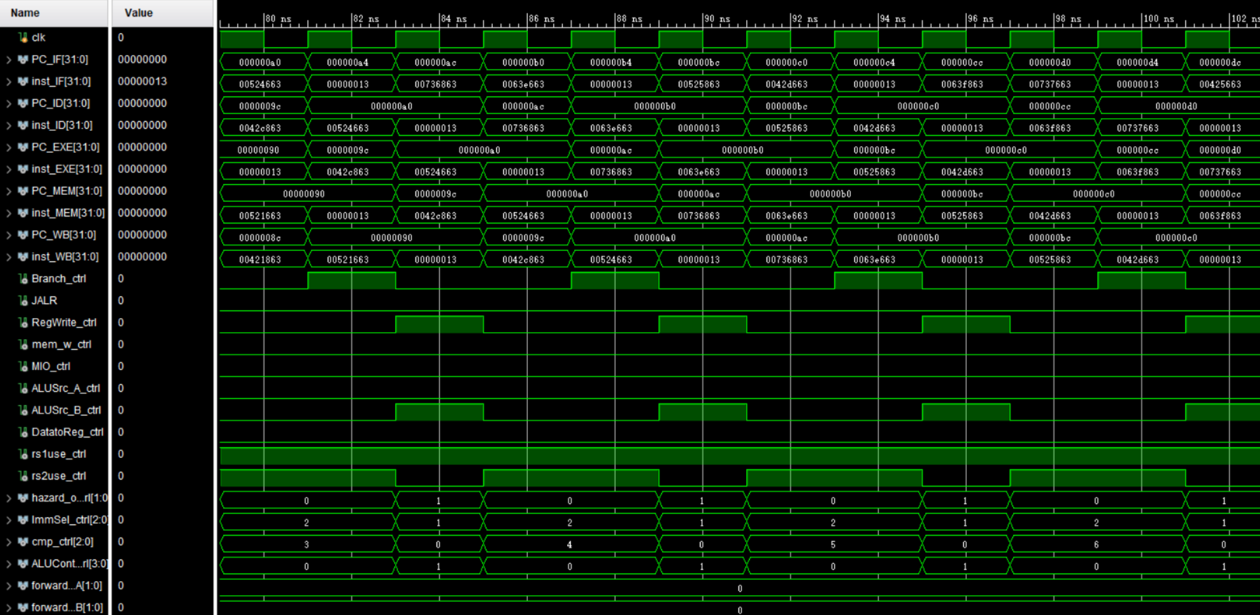
Simulation (5)

Slide 42
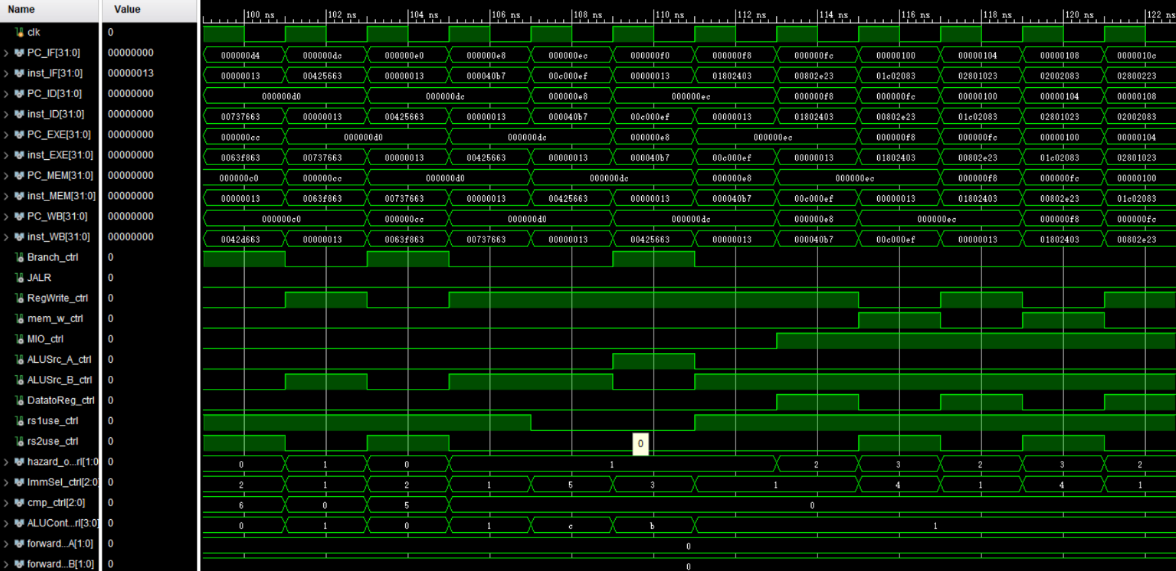
Simulation (6)

Slide 43
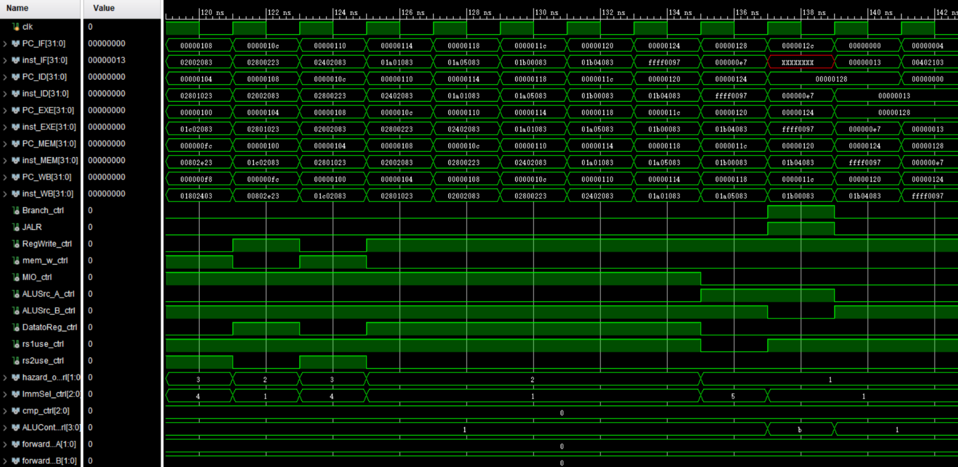
Simulation (7)

Slide 44
Checkpoints
CP 1:
Waveform Simulation of the Pipelined CPU with the verification program
CP 2:
FPGA Implementation of the Pipelined CPU with the verification program

Slide 45
理论知识自查
针对某条指令，其功能是什么，相关控制信号是什么？
流水线的3个hazard分别是什么？简要说明
Forwarding path加了几条？分别说明
就自己设计的代码而言，predict-not-taken 如果taken会stall几个周期？
测试代码相关问题
两条指令是否有数据依赖/数据冲突？有forwarding和没有forwarding分别stall几个周期？

Slide 46
Thanks!

